Slide 1
The Digestive system
Year 11 Biology
Bremer SHS

Slide 2
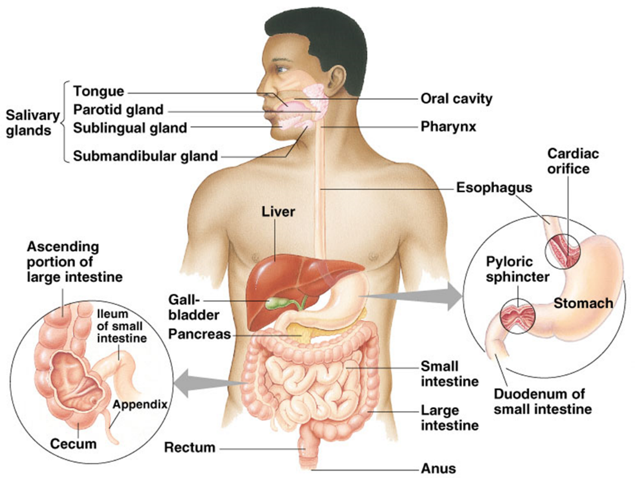
The digestive system
Includes the alimentary tract and accessory organs.
Components include: mouth, oesophagus, stomach, small intestine, large intestine (colon) and anus.
Accessory organs include: liver, gallbladder and pancreas.
Mechanically and chemically breaks down food for diffusion into blood.
Wastes are egested.

Slide 3
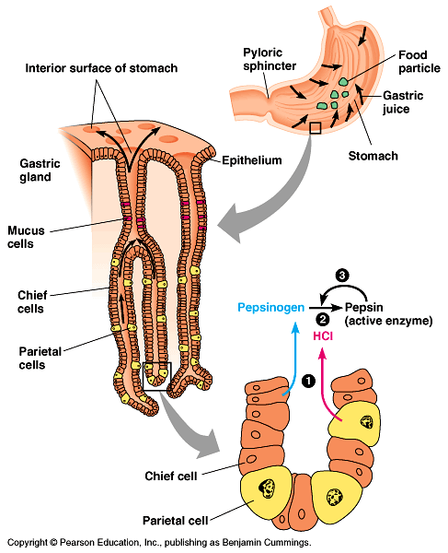
mechanical and chemical digestion
Inner Workings of the Stomach
Mechanical digestion occurs as a result of chewing (mouth) and muscle contraction (Stomach).
Chemical digestion occurs as a result of enzymatic activity.
Examples of digestive system enzymes:
Amylase - digests starch into simple sugars
Protease (inc. pepsin) - digests proteins into to amino acids
Lipase – digests lipids in to fatty acids and glycerol
Hydrochloric acid in the stomach does not work to digest food directly! Pepsin only active in acidic environments (pH 1-2) , hence HCl is secreted to activate the enzyme.

Slide 4
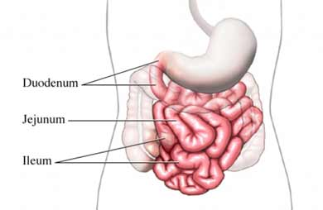
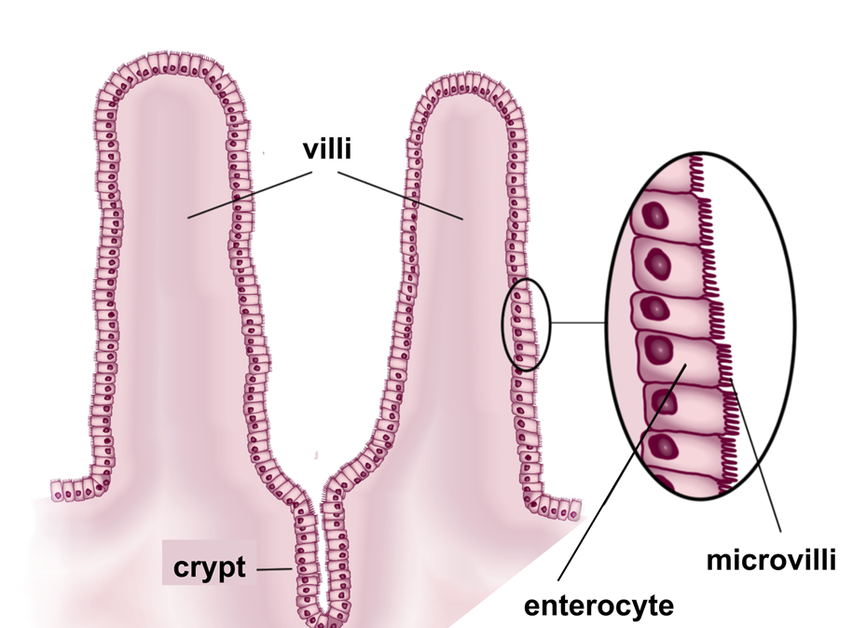
Absorption in the digestive system
The small intestine uses diffusion and active transport to move nutrients and water from the digestive tract in to the blood.
The small intestine is over 6 meters long and has a surface area of approximately 300m².
Uses secretions from gall bladder, pancreas and liver to aid process
The small intestine consists of three sections:
Duodenum = digestion of carbs, lipids and proteins
Jejunum & Ileum = diffusion of nutrients (simple sugars, fatty acids, amino acids, vitamins, minerals) & water into blood.
Contains villi and microvilli for increase surface area for diffusion.

Slide 5
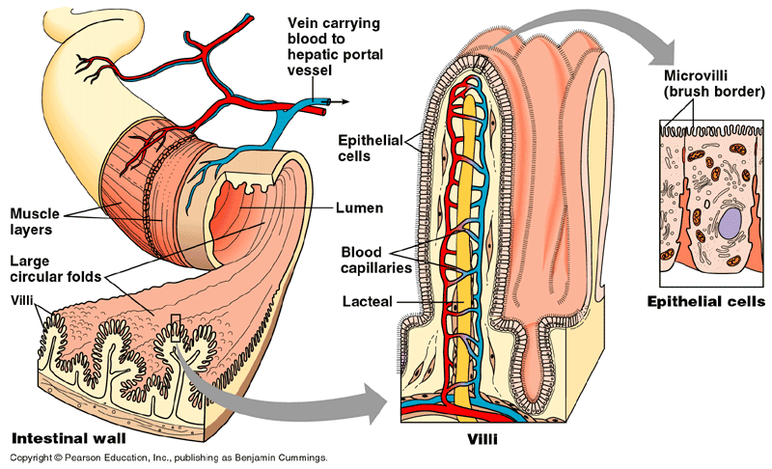
Villi (singular villus) project from the entire surface of the small intestine.
The boundary of each villus contains microvilli to dramatically increase the surface area for absorption.
Each villus is supplied with a network of capillaries and lymph vessels.
Nutrients and water only have to cross a digestive surface two cells thick to move from the intestine to the transport vessels.

Slide 6
Check for understanding
Table 1 – average daily nutrient requirements for males and females of varying age groups
 | Age | Mean Body Mass (kg) | Protein (g) | Calcium (mg) | Iron (mg) | Vitamin C (mg)
Women | 18 – 35 | 60 | 58 | 400 – 800 | 12 | 30
Men | 18 – 35 | 70 | 70 | 400 - 800 | 10 | 30
Girls | 15 – 18 | 55 | 60 - 65 | 500 - 1300 | 12 | 50
Boys | 15 - 18 | 61 | 67 - 90 | 500 - 1400 | 12 | 50
Questions to Answer
Identify the vitamin C requirement for adolescent boys.
Calculate the difference in protein requirements for adult males and females.
Contrast the mean body mass for males and females.
In addition to building bones and keeping them healthy, calcium enables our blood to clot, our muscles to contract, and our heart to beat. Suggest a reason why calcium requirement is much higher for adolescents than adults.

Slide 7
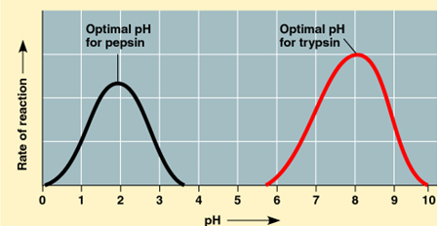
Check for understanding
Figure 1 – enzyme activity at varying pH levels
Questions to Answer
Determine the pH for peak activity for the enzyme trypsin.
Contrast the activity of pepsin and trypsin.
One enzyme hydrolyses proteins in the small intestine and one breaks down proteins in the stomach. Use data to infer what section of the human digestive system the enzyme is active in.

